Slide 1

AI Capabilities - Big dream
Shaping the future of AI
June 2024

Slide 2

1
FPT’s AI Capabilities
2
AI Offerings and Solutions
AGENDA
3
Our transformation journey with xVista
© Copyright FPT Software 2024

Slide 3
01.
Our AI Capabilities
Notes:
Let’s talk about our BIG DREAM - SHAPING THE FUTURE OF AI

Slide 4

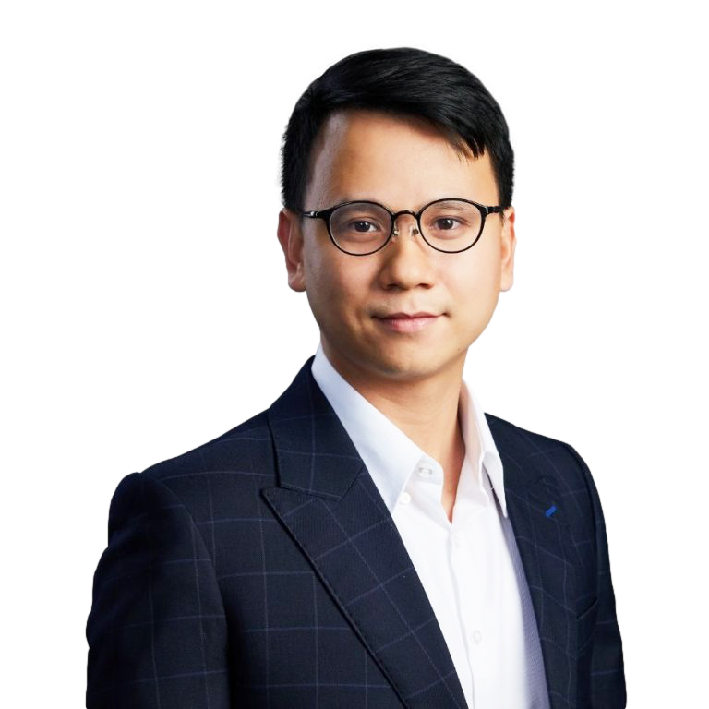



01. AI CAPABILITIES - BIG DREAM SHAPING THE FUTURE WITH AI
VISION 2025
SHAPING THE FUTURE OF AI
Top 50 AI Center Worldwide
Dr. Nguyen Xuan Phong
Chief AI Officer, FPT Software
We strive to deliver the best-in-class performance to our clients by developing Artificial Intelligence Services that optimize operations, unlock the value of data, empower employees and promote innovation.
No. 1 AI Center at Vietnam
World-class AI Products

Slide 5
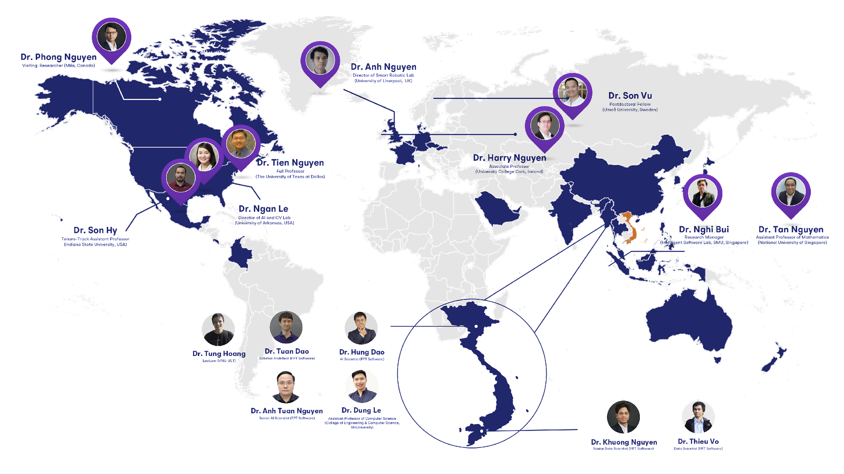



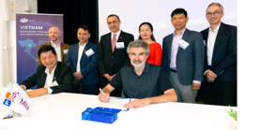
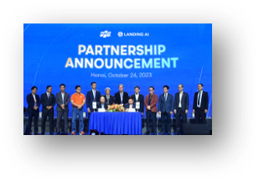
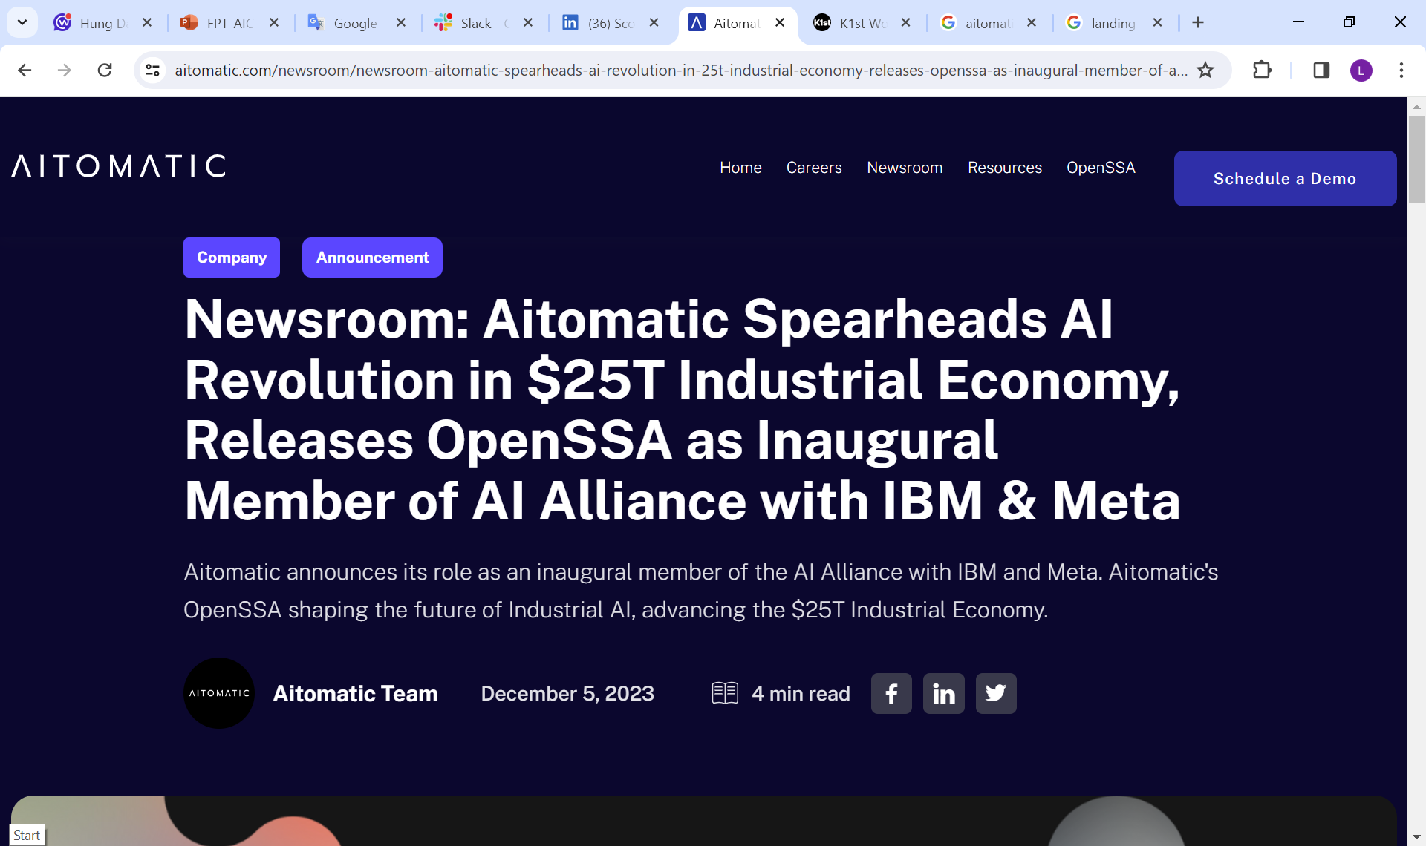
























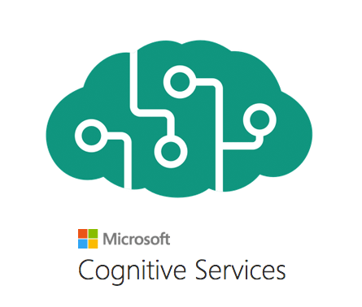


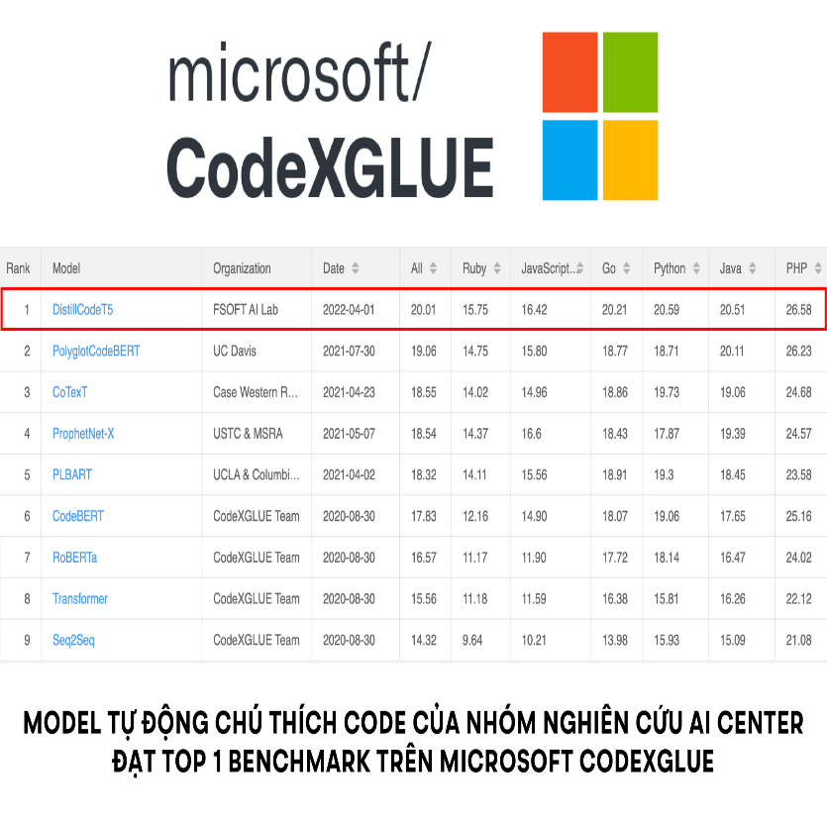
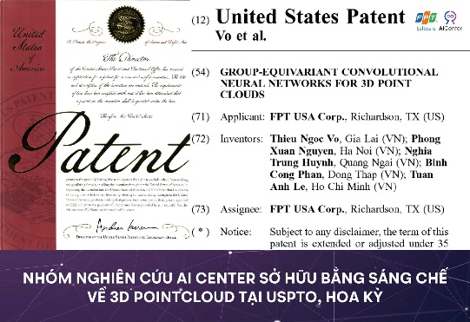


How FPT Is Shaping The Future with AI
Global AI Talent Human Resources
Strategic Partner
1.000 +
50 +
400 +
180 +
500 +
AI Professionals
AI Scientists
AI Engineers
Data Analysts
Subject-matter experts
Human
Resources
Partner-
ship
50+ Ph.D.
65 Accepted Papers
45 Top-tier *Publications
Infrastructure
Data Center & Cloud Service
Emerging AI Technology
Infra-
Structure
NVIDIA DGX H100
Full scale Cloud based AI Service
On-premises, hybrid, multi cloud, or at the edge- create secure, future-ready cloud solutions
AI Revolutionizes Software-Defined Vehicles (SDVs)
Technology
Large Language Model
Large Vision Model
Large Code Model
Code Summarization
Microsoft Benchmark No 1
US Patent
3D Point Cloud
Japan Patent
ViT
Invest $200 Million USD
NVIDIA Hopper GPU accelerators
deliver up to 400 teraflops of performance
https://microsoft.github.io/CodeXGLUE/
5
Notes:
As you know, FPT was established in 1988 with only 13 founders. In 20 years, we have become a world-class software and IT services company. Now, we dream even bigger: to become a world-class AI leading company.
We have made significant progress towards this goal, such as our collaboration with Mila Research Institute and Landing AI.
We want to achieve our goal of having 1 billion Digital transformation employees by 2035.
We believe that AI has the potential to revolutionize the way we work and live, and we are committed to making this a reality.

Slide 6









Partnership & Certifications
Partnership status
Partnership status
Partnership status
AI and Machine Learning on Microsoft Azure specialization
Gold Application Development
Gold DevOps
Gold Cloud Platform
Gold Data Analytics
Public Sector
Migration & Modernization Competency
Marketplace Seller
Solution Provider
Service Partner
Service Delivery Partner / Global SI
Cloud Partner (NCP)
Global Network
Resources
Resources
Resources
2,800 experienced experts in Microsoft
500+ Microsoft AI & Data Certifications
600+ AWS experts
100+ AI associates and professionals
8,800+ NVIDIA Certifications
Resources
Resources
Resources
Resources
Resources
170+ Certifications
10+ Certifications
50+ Certifications
20+ Certifications
50+ Certifications

Slide 7
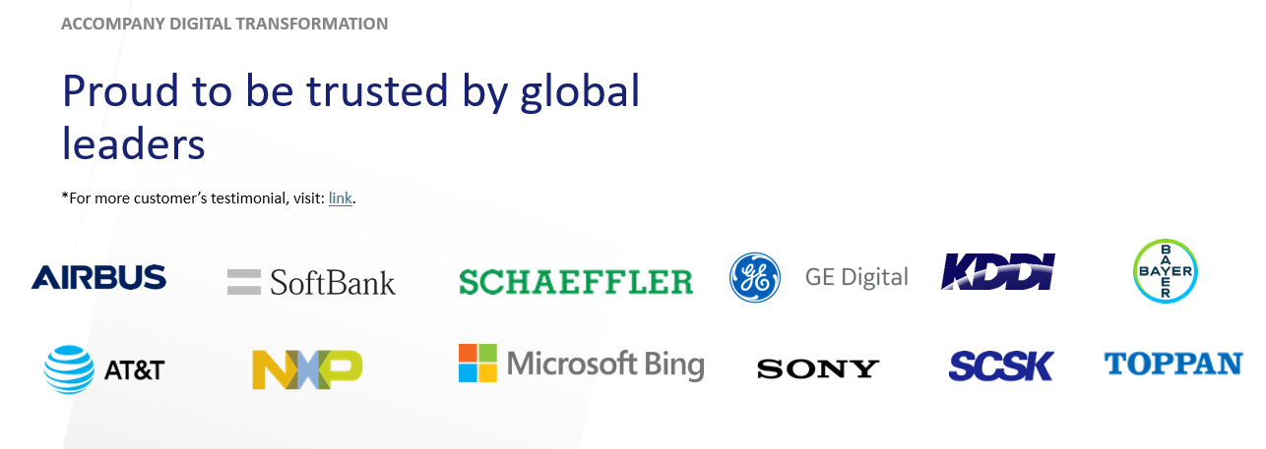
Our clients and Hundreds of On-going projects
We provide AI services to customers in different industries world-wide
200+
AI Projects
Completed
100+
AI Projects
On-going
Notes:
Our AI users include customers from Vietnam, Japan, and across Europe in various industry such as manufacturing, automotive, utilities, consumer products and others…

Slide 8
02.
AI Offerings & Solutions
Notes:
Let’s talk about our BIG DREAM - SHAPING THE FUTURE OF AI

Slide 9





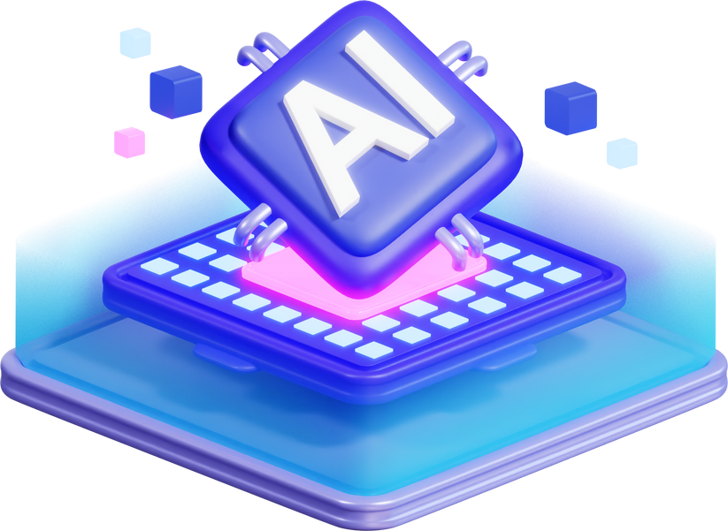


How we help clients with AI transformation journey?
3. Development
4. Scale up
Start implementing company’s digital capabilities in selected domains and using them live to improve some individual pain-points
Scaling up from successful development to other domains and business processes.
03
04
2. Kickstart
5. Production
Kickstart pilot models, building core data pipelines, and mitigating risk and bias while measuring value.
Use-case Demonstration
Horizontal and industry-specific Accelerator
02
05
Leverage AI capabilities for end-to-end operations, ways of working, and successful customer’s engagement
1. Inception
01
06
6. AI State of Mind / Ethical AI
Explore and validate what’s possible with AI through workshops and set an inspiring vision across the organization.
Validation of vision
Innovation Labs as a service
Envision Responsible AI and Ethical AI framework. Promote AI model safety and data governance across the organization.
‹#›

Slide 10










Overall FPT Software’s AI Offerings
PRODUCTS
Docify AI
Generative AI for Enterprise
Generative AI for Software
Video Analytics
Digital Twins
Data Science & Analytics
Solutions
Virtual Assistant/
Personalization Virtual Assistant
Smart Cities & Spaces
Mainframe Migration
Factory Digital Twins
Retail Forecasting
Knowledge Management
Coding Assistant
Industrial Inspection
Production Line Optimization
Fleet Command
Specialist / Domain-Specific Agent
Code Quality
Edge Vision AI
Predictive Maintenance
Predictive Maintenance
NVIDIA Framework
Nemo LLM
Metropolis
Ominiverse
RAPIDS
Services
Consultancy
Data Engineering
Data Cleansing & Annotation
AI Development
MLOps / LLMOps
Maintenance
Data Security
Infra & Hardware
Cloud
Hardware (GPU, Switch,..)
Server
Database
Infra
Services
Consultancy
System Integration
Managed Services
CloudOps / DevSecOps
Notes:
Our AI users include customers from Vietnam, Japan, and across Europe in various industry such as manufacturing, automotive, utilities, consumer products and others…

Slide 11
AI Capabilities – Core Vertical’s use cases
Industrial & Manufacturing
Quality control with visual / sound inspection | Predictive Maintenance with IoT / Digital Twins | Advanced Production Planning / Scheduling | Production process prediction / root cause analysis | GenAI Virtual Domain Expert | Construction drawing extraction
In-car virtual assistant | AI in ADAS | AI for Autonomous Driving | Embedded AI
Renewable energy generation prediction | Energy consumption optimization | Electric charging station planning & optimization | Power station & Grid visual inspection | Wind turbine monitoring
Demand Forecasting | Semantic Search | Conversational eCommerce & Retail | Personalized Product Recommendation | Lookalike audience for lead generation | Retail distribution optimization | Personal Travel & Logistics Assistant
Personalized Virtual Financial Advisor | Insurance Agent Virtual Assistant | Fraud Simulation & Pattern Detection | AI-powered automated underwriting | eKYC | Churn Prediction | Sentiment Analysis / Social Listening
AI-Assisted Drug Discovery | Ambient Digital Scribe | AI-assisted Medical Imaging | Epidemic Prediction | Pharma Pill / Bottle Inspection | Patient Monitoring with AI Camera and IoT Devices
Predictive ETA | Route Optimization | Virtual Logistics Assistant | Dynamic Pricing
AI Coding Assistant | Autonomous Code Generation & Completion | Autonomous Bug Fixing | AI-Assisted Legacy Migration | Automatic Code Documentation tool | AI for Project Management & Project Success
Automotive
Utilities & Energy
Consumer & Retail
BFSI
Life Sciences & Healthcare
Logistics & Transportation
Technology
Implementation | PoC | Intent

Slide 12
03.
Our transformation journey with xVista
Notes:
Let’s talk about our BIG DREAM - SHAPING THE FUTURE OF AI

Slide 13









xVista Ecosystem Product Features
Code Explanation
Code Generation
Code Refactor
Bug fixing
Code Documentation
Minutes to Business Requirements
Software Specs Generation
Diagram Generation
Unit Test Generation
Test Case Generation
Test Data Generation
Risk forecast
Q&A for project teams
Project planning automation
*BaVista, TestVista, PmVista are in the MVP phase.

Slide 14
xVista Ecosystem Product Status
Products
Status
Placement
Production Ready
IDEs Extension
In POC Phase
Web application
xVista
Ecosystem
In MVP Phase
Web application
In MVP Phase
Web application

Slide 15



FPT Software Objectives in 2024
30%
Productivity boost with adoption of Generative AI
15k
FPT users in all projects assisted by AI
5/6
Aspects of software development enhanced by AI
© Copyright FPT Software – Internal Use only

